Slide 1
DmpRootIOSvc and Data Buffer
Chi WANG chiwang@mail.ustc.edu.cn
Guangshun HUANG hgs@ustc.edu.cn
30/06/2014

Slide 2
Contents
Why we need it?
IO
Data communicate between algorithms
Implementation
DmpRootIOSvc
Time sequence
DmpVAlg
DmpCore
DmpVSvc
How to use it?
In job option file
In concrete algorithm
Example

Slide 3
Why we need it?
One Job( an object of class DmpCore)
AlgMgr(Algorithm Manager)
SvcMgr(Service Manager)
Algorithm_0
Algorithm_0
Algorithm_0
IO service
Algorithm_0
Algorithm_0
Service_0
Event class: DmpEvt_Alg0_Input
DmpEvt_Alg0_Output
Input root file
Output root file

Slide 4
Why we need it?
One Job(an object of class DmpCore)
Another Job(an other object of DmpCore)
Algorithm_0
IOSvc
Algorithm_1
IOSvc
same
DmpEvt_Alg0_Input
DmpEvt_Alg0_Output
DmpEvt_Alg1_Input
DmpEvt_Alg1_Output
Input root file
Output root file
Output root file_2

Slide 5
Why we need it?
One Job(an object of class DmpCore)
Another Job(an other object of DmpCore)
Algorithm_0
IOSvc
Algorithm_1
IOSvc
same
DmpEvt_Alg0_Input
DmpEvt_Alg0_Output
DmpEvt_Alg1_Input
DmpEvt_Alg1_Output
Input root file
Output root file
Output root file_2
Feature: Data communication,
How to combine 2(more) algorithms in one job?

Slide 6
We need IO Service and Data buffer
One Job
DmpRootIOSvc
NOTE:
DmpEvt_Alg1_Input == DmpEvt_Alg0_Output
Data Buffer
Algorithm_0
Algorithm_1
DmpEvt_Alg0_Input
DmpEvt_Alg1_Input
DmpEvt_Alg0_Output
DmpEvt_Alg1_Output
Read only
Input root file
Output root file
Read and Write
可在Job option中选择性写出一个或多个Algorithm 的output数据

Slide 7
DmpRootIOSvc: for job option
User Interface(setting option):
void Set(string option, string value)
option and value
Option = InData/Read
value= any root file (extension must == “.root”)
InData/Update
value = any root file (extension must == “.root”)
write new data into input root file
OutData/FileName
value = any string
If NOT set, will write nothing
OutData/Write
Important
If NOT set, will write nothing

Slide 8
DmpRootIOSvc: for concrete alg.
User Interface (Read or Register data):
TObject* ReadObject(string path)
// Read data from data buffer
template<typename T>
bool RegisterObject(string path,
string className, // name of event class
T *&dataPtr)
// register event class into data buffer. Book branch automatically
template<typename T>
bool RegisterObject(string path,
T *&dataPtr)
// register TClonesArray into data buffer, Book branch automatically

Slide 9
Time sequence
Job option
DmpCore
DmpRootIOSvc
Algorithms
Initialize
Initialize
RegisterObject
Initialize
(create object of output data)
ReadObject
(loop)ProcessThisEvent
Run(loop)
ProcessThisEvent
If all alg. succeed
FillEvent
Finalize
Finalize
Finalize

Slide 10
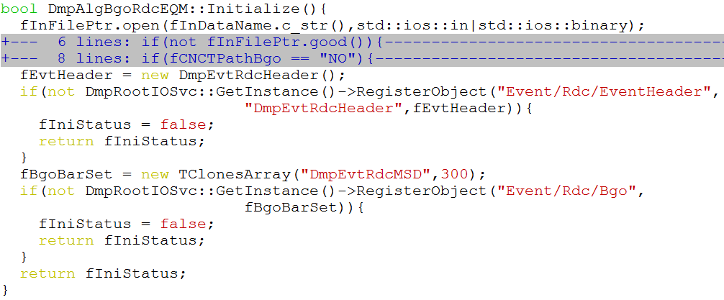
How to use it?
RawDataConversion/Bgo/BgoRdcEQM

Slide 11
Out file structure
split by ;

Slide 12
Conclusion
Provide IO service for root files, DmpRootIOSvc
Provide Data buffer
Data communicate between algorithms
Thank you

